Slide 1
Docker for .NET Development

Slide 2

Objectives
Briefly highlight what Docker is (and isn’t)
Describe Docker components
Basic Commands
Demo
Docker Gotcha’s

Slide 3
What is Docker?
Allows us to bundle software in a way that is easy to deploy/distribute.
Saves money by reducing the resource footprint on our environments.
Allows you to run the exact binary that get’s deployed on your machine eliminating the need for a full dev environment.
Notes:
Initially released in 2013 and fully integrated into Windows Server in 2014.

Slide 4
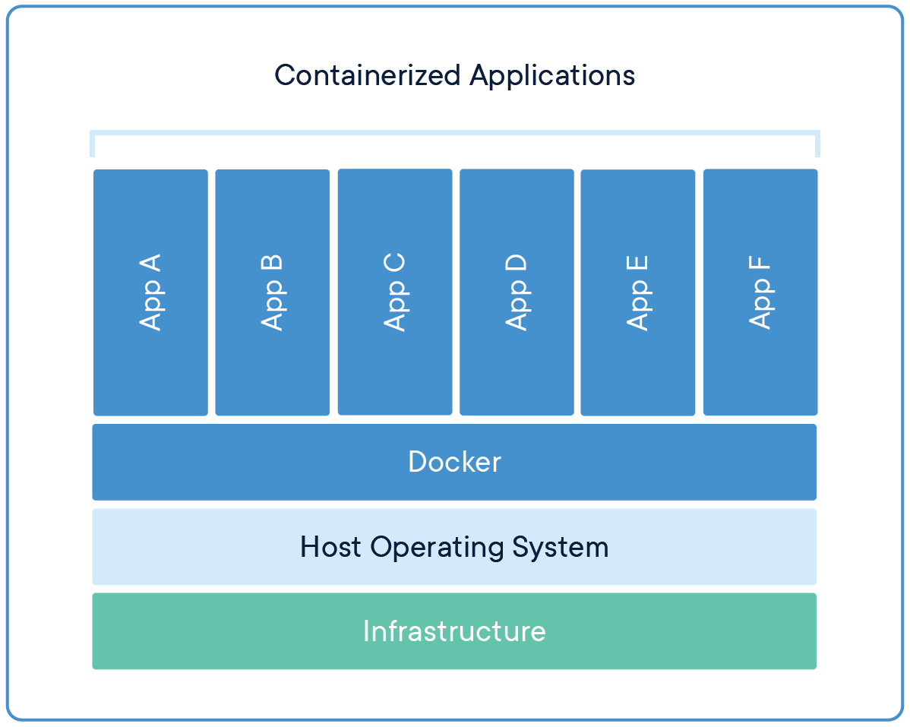
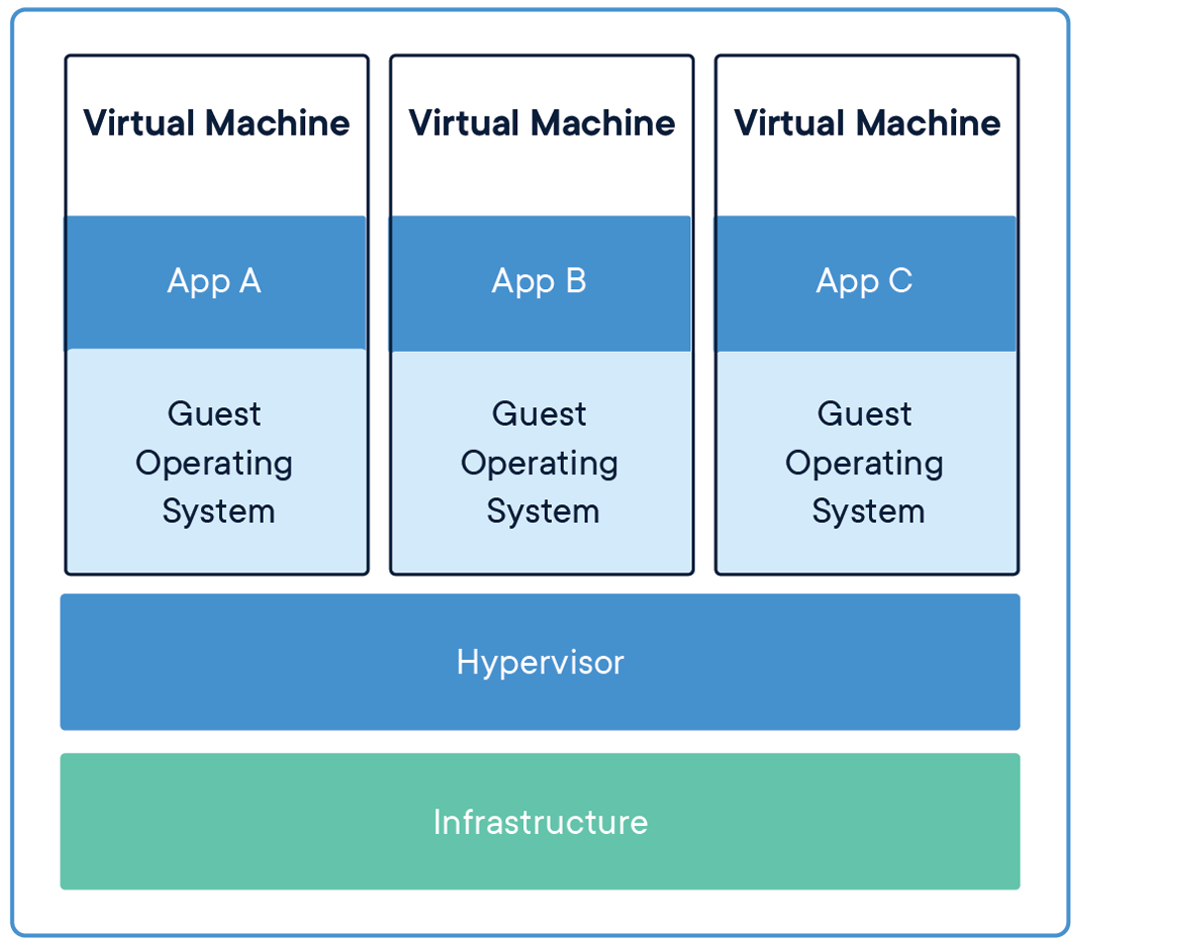

Slide 5
Docker is not:
A virtual machine.
A replacement for a virtual machine.
A magic bullet for: Security, DevOps, Microservice Architecture, Release Pipeline

Slide 6
Docker Components
Docker Daemon
Docker Client
Images
Containers
Volumes
Services
Registry
Notes:
Manages docker objects on the host
Lets you interact with the Daemon
Containers are the encapsulated environments that run the applications
Images are the read-only binaries that are templates for the containers
Services allow containers to run across multiple docker daemons
Registry is where you store your

Slide 7

Docker Damon

Slide 8
Docker Daemon
Builds images.
Manages containers, networks, and volumes.
Exposes REST API.

Slide 9
Docker Client
Interfaces with the daemon.
Allows you to manage objects in Docker.

Slide 10
Images
A package with everything needed to run a piece of software.
Made up of layers that get built from instructions in a Docker File.
Not the same thing as a Dockerfile

Slide 11
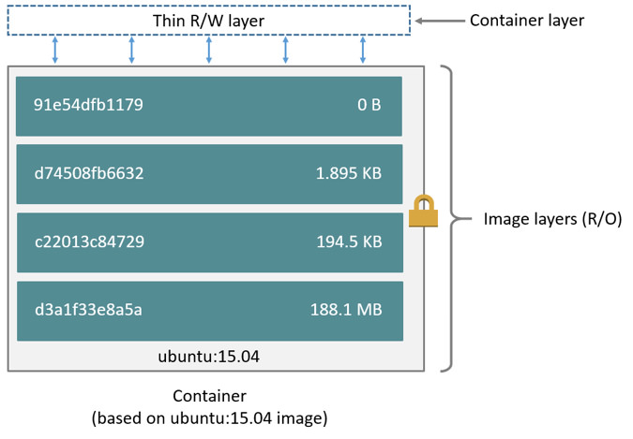
Notes:
Layers will be based on an image
The copy on write strategy

Slide 12
Containers
The runtime instance of an image that runs in isolation from the host environment.
Run apps natively on the Kernel. (They actually get a PID)
Containers get native access so your apps will run as processes in the host.
Notes:
Layers will be based on an image

Slide 13
Volumes
A way to persist state beyond the destruction of a container.
Use a portion of the available disk space in your Docker folder.
Slightly different from Bind mounts and tmpfs
Notes:
Layers will be based on an image

Slide 14
Services
Services allow you to make your containers scalable.
You can use an overlay network to access other nodes in your Swarm.
Define what resources you need to run your container.
Notes:
Layers will be based on an image

Slide 15
Registry
The repository for docker images.
Can be self-hosted, public/private, or in the cloud.
Is used for both images and running containers
Notes:
Layers will be based on an image

Slide 16
Basic Commands
docker ps
docker ls
docker build
docker images
docker tag
docker push
docker run
docker rm
docker logs
docker exec –it CONTAINER_ID /bin/bash
Notes:
Layers will be based on an image

Slide 17
Demo
Creating images.
Pushing to a registry.
Deploying an image.
Debugging.

Slide 18
Gotcha’s
Running “docker build” in the terminal doesn’t work.
Containers not talking.
Docker container is crashing every time!
I’m pointing to a service on my network but my container isn’t finding it.
What About Databases?!?
What are the hashes I see when I push my docker image
Windows vs Linux Hosts

Slide 19
Resources
12 Factor Methodology
Container Debugging
Mastering Chaos – A Netflix Guide to Microservices

